Slide 1
Priscilla Loebenberg
Credit One
Data Science Framework Report

Slide 2
Design and implement a creative, empirically sound solution to decrease the number of customers defaulting on loans secured through various partners of Credit One using client data
Goal

Slide 3
Data Science Process Framework
Business Question
Analysis Plan
Data Collection
Insights
Recommendations
The BADIR Framework will be utilized because it focuses on business question we are seeking to answer and provides for recommendations that may be used to meet our goal of decreasing defaults.
B.A.D.I.R.

Slide 4
Data Management
Data Source
Data Location
Data Security
Historical data provided by Credit One with client histories and default statuses
Client data will be stored on a secure computer system
Client data will be kept secure and private. No client names or identifying information will be included in any material.

Slide 5
Data Description
Data includes demographic and educational information as well as amount of credit given, payment history for six months, amount of bill statements for six months, amount of previous payment for six months and default status

Slide 6
Potential Issues with Data
Data referring to client sex, age, marital status should not be used in our process in order to avoid any potential issues with recommendations that could be seen as discriminatory.

Slide 7
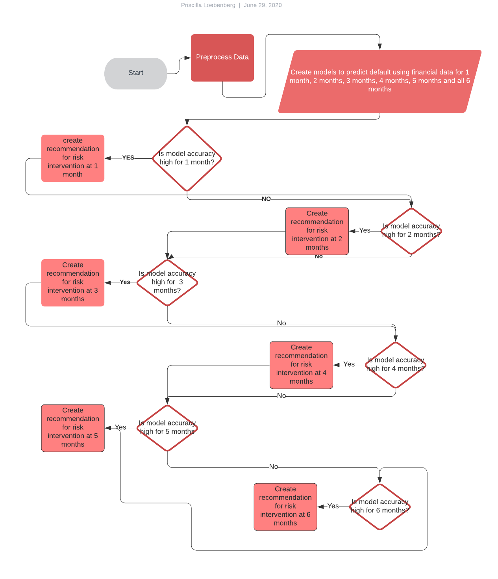
Flowchart

Slide 8
Initial review of data

Slide 9
Insights
Because it would be beneficial to identify clients at risk of default as quickly as possible, a method will be created to make recommendations for intervention at the earliest point possible.
Based on an initial review of data, there appears to be a vast difference in the average payment history for default vs. non-default clients beginning in the first month of recorded payment history.
It may be beneficial to calculate the amount paid as a percentage of the total statement amount and include that as a variable in our calculations

Slide 10
THANK YOU

